Slide 1
Semi Supervised Learning
Linnea Hall

Slide 2
Outline
Review of Supervised and Unsupervised learning
Semi-Supervised Learning
Applications
Lit Review

Slide 3
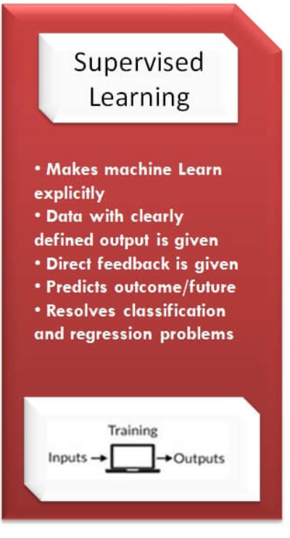
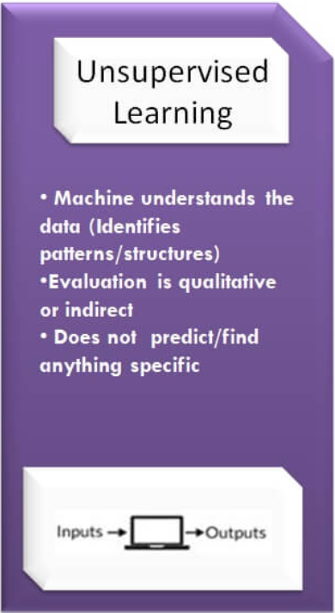
Review
VS.
https://www.newtechdojo.com/list-machine-learning-algorithms/

Slide 4
Challenges of Supervised/Unsupervised Learning
What are the challenges of supervised learning?
What are the challenges of unsupervised learning?
Notes:
Challenges of Supervised:
Enough labeled data.
External data to validate.
Data quality like Noise/outliers, non-linearity.
Time and memory constraints.
Challenges of Unsupervised
Validation: quantitative vs qualitative also intra (in) cluster and inter (between) clusters.
Data quality like Noise/outliers, non-linearity.
Time and memory constraints.

Slide 5
Semi-Supervised Learning
Counter the disadvantages of supervised/unsupervised learning with semi-supervised learning, especially in regards to medical data.
Semi-supervised learning starts with little labeled data and lots of labeled data.
Use unsupervised learning algorithm to cluster similar data together
Use labeled data to finish labeling the unlabeled data
https://www.geeksforgeeks.org/ml-semi-supervised-learning/

Slide 6
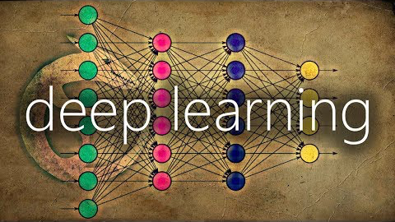
Semi-Supervised Learning
https://www.youtube.com/watch?v=b-yhKUINb7o

Slide 7
Semi-Supervised Data Assumptions
Continuity Assumption
Points close to each other are likely to have the same output label
Cluster Assumption
Data can be divided into discrete clusters and points in the same cluster will share the same the output label
Manifold Assumption
The data lie approximately on a manifold of much lower dimension than the input space. This assumption allows the use of distances and densities which are defined on a manifold
https://www.geeksforgeeks.org/ml-semi-supervised-learning/

Slide 8
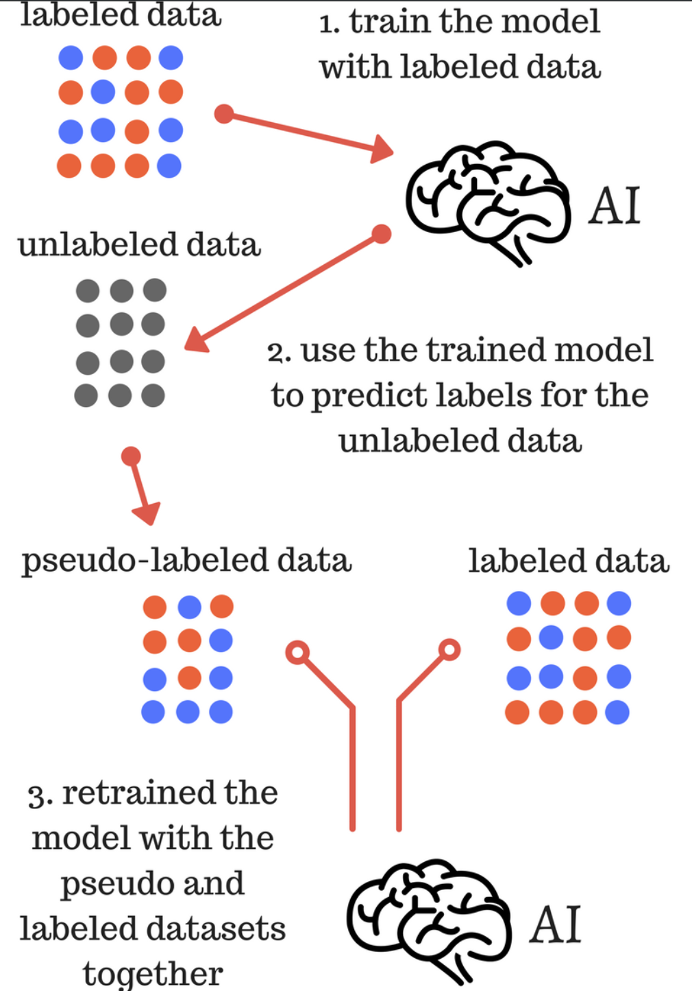
The Art of Pseudo-Labeling A simple semi-supervised learning method

Slide 9
Applications for Semi-Supervised Learning
Speech Analysis
Hasegawa-Johnson, Mark A., Jui-Ting Huang, and Xiaodan Zhuang. "Semi-supervised Learning for Speech and Audio Processing." The Journal of the Acoustical Society of America 130.4 (2011): 2408. Web.
Internet Content Classification
Zhu, Sun, and Jin. "Multi-view Semi-supervised Learning for Image Classification." Neurocomputing 208 (2016): 136-42. Web.
Protein Sequence Classification
Jason Weston, Christina Leslie, Eugene Ie, Dengyong Zhou, Andre Elisseeff, William Stafford Noble, Semi-supervised protein classification using cluster kernels, Bioinformatics, Volume 21, Issue 15, , Pages 3241–3247, https://doi.org/10.1093/bioinformatics/bti497

Slide 10
Detecting disease genes based on semi-supervised learning and protein–protein interaction networks Thanh-Phuong Nguyen and Tu-Bao Ho Artificial Intelligence in Medicine, 2012-01-01, Volume 54, Issue 1, Pages 63-71, Copyright © 2011 Elsevier B.V.
25 – 30,000 genes in the human body
Known disease genes, known non-disease genes, and yet-unidentified genes
Researchers have been studying human protein-protein interaction(PPI) networks to predict human disease genes via their corresponding product proteins, which are called disease proteins.
The key to this is the exploration of the neighborhood relatedness based on the assumption that “the network-neighbor of a disease gene is likely to cause the same or a similar disease”
“It is known that genes associated with a particular phenotype of function are not randomly positioned in the PPI network, but tend to exhibit high connectivity; they cluster together and occur in central network locations.”
REMEMBER our data assumptions for SSL!

Slide 11
Experiment
Two comparative evaluations performed, each employing a 10 times stratified 10-fold cross validation
1) Evaluate the SSL method, the k-NN method, and the SVMs in terms of sensitivity, specificity, precision, accuracy, and a balanced F-function.
2) Estimate accuracy of the SSL method and the K-NN method with different data sizes of the labeled data set.
Notes:
The k-NN method is a typical classification method
that assigns class label to a unknown object based on the majority
of its nearest neighbours in the known classes. The SVMs method
is a typical kernel method that learns a hyperplane to separate two
classes with their maximized margin.

Slide 12
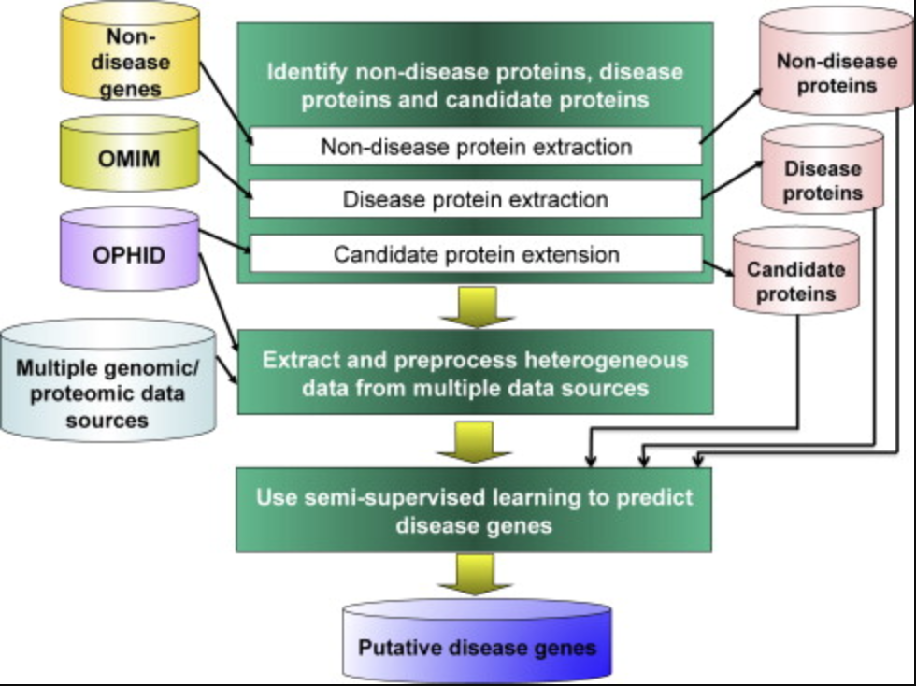
SSL Method
Notes:
Online Mendelian Inheritance in Man

Slide 13
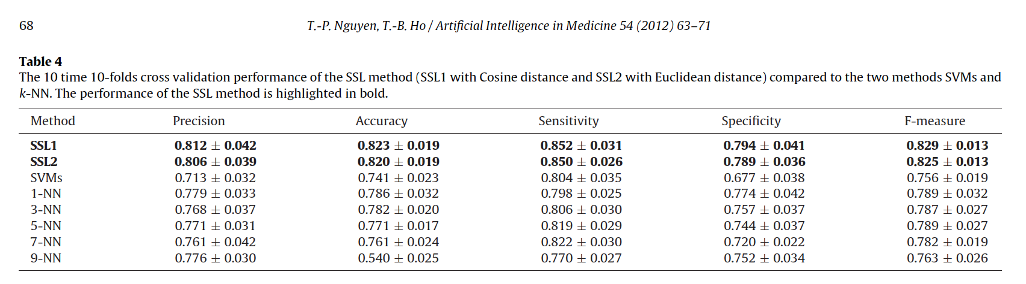
Results

Slide 14
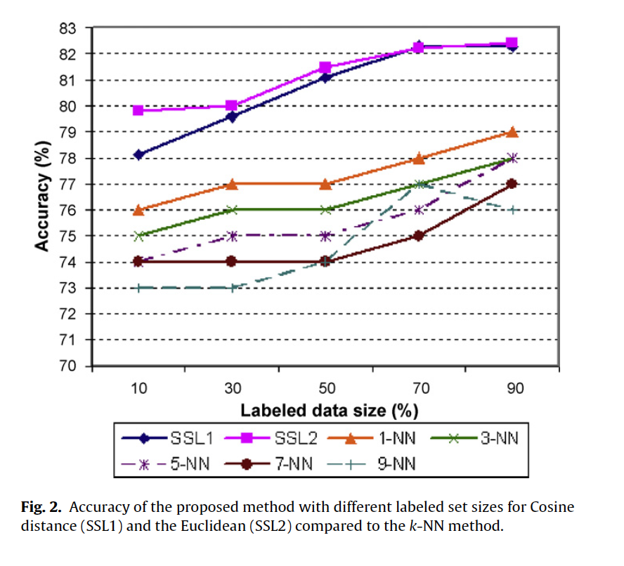
Results

Slide 15
Conclusions
Semi-supervised learning improved ability to study disease genes
Semi-supervised learning helps overcome the challenges of supervised and/or unsupervised learning
Semi-supervised learning is cool!

Slide 16
References
Websites used as references are indicated on their respective slides

